Slide 1
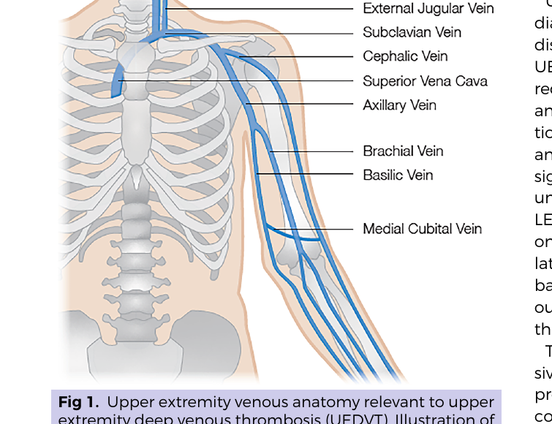
ARTICLE IN PRESS
AVF UEDVT Guideline
Final findings + response to imaging critique
Rafael Demarchi Malgor, MD, MBA, FSVS, FACS
Division of Vascular Surgery and Endovascular Therapy
University of Colorado Anschutz Medical Center
Clinical Practice Guideline on the Care of Patients with Upper Extremity Deep Venous Thrombosis
Notes:
Open by stating that this revision is focused on the final findings and the response to the imaging critique. Keep the framing direct: this guideline standardizes an etiology-first, evidence-based approach to UEDVT.

Slide 2
WHAT THE GUIDELINE CHANGES
Final findings in one minute
This is not an “arm version” of leg DVT.
01
Etiology first
02
Central disease cannot be missed
vTOS, catheter/device, cancer, and noncatheter UEDVT are different diseases operationally.
Duplex first, but high suspicion after a negative duplex requires escalation.
03
Stop reflex prophylaxis
04
Treat broadly; intervene narrowly
Routine anticoagulant prophylaxis solely for long-term CVCs is a Grade 1A “do not.”
Xa inhibitor for ≥3 months is default; thrombus removal and SVC filters are selected exceptions.
Bottom line: standardize the pathway, document the why, and avoid treatment by habit.
AVF UEDVT Clinical Practice Guideline, JVSVL 2026
1
Notes:
This slide is the executive summary. Emphasize that the most practice-changing statements are etiology-first management, imaging escalation when central disease is suspected, no routine prophylaxis solely for long-term CVCs, and selective use of invasive therapy.

Slide 3
RATIONALE
Why UEDVT needs its own playbook
5–10% of DVT
Complications matter
UEDVT is a meaningful share of DVT, not an anecdotal diagnosis.
PE, recurrence, bleeding, and post-thrombotic syndrome drive morbidity and resource use.
Device-driven incidence
Practice variation is the enemy
CVCs, PICCs, pacemakers, ICDs, and ECMO change the risk profile and the prevention question.
The guideline gives a reproducible framework for diagnosis, prophylaxis, and treatment.
Do not extrapolate blindly from lower-extremity DVT.
AVF UEDVT Clinical Practice Guideline, JVSVL 2026
2
Notes:
Use this as the why slide: UEDVT has unique anatomy, risk factors, outcomes, and device-driven epidemiology.

Slide 4
FRAMEWORK
Final finding #1: classify by etiology, not anatomy alone
First question: WHY did the clot happen?
vTOS-associated
Catheter / device-associated
Noncatheter / secondary
Effort thrombosis / Paget–Schroetter
CVC • PICC • pacer/ICD • ECMO
Cancer • thrombophilia • trauma/surgery
Younger, fewer comorbidities; compression at the costoclavicular space.
Management implication: fix the root cause — decompression matters.
Common in inpatients; decisions hinge on access need, VTE risk, and bleeding risk.
Management implication: treat the clot; do not remove necessary access reflexively.
Older/comorbid groups; drivers vary and invasive treatment is individualized.
Management implication: treat the clot and investigate the underlying cause.
The remaining recommendations hinge on this first sort.
AVF UEDVT Clinical Practice Guideline, JVSVL 2026
3
Notes:
Aggressive framing: the guideline moves away from anatomy-only labels toward etiology because management differs by mechanism.

Slide 5
DIAGNOSIS
Final finding #2: do not stop at a negative duplex
Duplex is the first test — not the last word when central disease is suspected.
Clinical suspicion
→
Duplex ultrasound
→
Positive
Escalate imaging
Arm swelling, pain, catheter/device, vTOS context
First-line test
Grade 1B
Treat by etiology
MRV preferred when available; CTV when clinically practical
or
Negative + high suspicion
→
Central veins can be missed
Hard stop: a negative duplex does not exclude proximal subclavian/innominate disease when the pre-test probability is high.
AVF UEDVT Clinical Practice Guideline, JVSVL 2026
4
Notes:
Emphasize the blind spot of duplex in central veins. MRV is preferred when available based on the evidence; CTV remains clinically reasonable when MRV is not available or not practical.

Slide 6
PROPHYLAXIS
Final finding #3: stop reflex prophylaxis for long-term CVCs
DO NOT
Use routine anticoagulant prophylaxis solely to prevent catheter-associated UEDVT in patients with long-term CVCs.
GRADE 1A
What to do instead
Use prophylaxis when VTE risk justifies it
Avoid mechanical compression as a substitute
Moderate-to-high VTE risk + acceptable bleeding risk. This is a documented risk/benefit decision, not a default reflex.
Mechanical devices are not recommended as sole prevention for UEDVT and should be avoided for CA-UEDVT.
The “win” is less unnecessary bleeding without abandoning true VTE prevention.
AVF UEDVT Clinical Practice Guideline, JVSVL 2026
5
Notes:
This is the most powerful practice-changing statement: no routine anticoagulant prophylaxis solely for long-term catheters. Be direct and unapologetic.

Slide 7
TREATMENT
Final finding #4: treatment is broad; intervention is narrow
Default
Thrombus removal
vTOS with compatible imaging
Consider only for acute extensive UEDVT (<21 days), severe symptoms, and life expectancy >1 year.
First rib resection is recommended as initial operative management.
Oral Xa inhibitor
≥ 3 months
For UEDVT with low bleeding risk.
Catheter-associated UEDVT
SVC filter
GRADE 1B
Anticoagulate. Remove catheter only if no longer needed or if alternative access is feasible.
Reserve for rare, highly selected patients with absolute anticoagulation contraindication and life-threatening PE risk.
Do not turn every UEDVT into a procedure. Do not undertreat the clot.
AVF UEDVT Clinical Practice Guideline, JVSVL 2026
6
Notes:
The aggressive phrasing here is deliberate: anticoagulation is the broad default; invasive therapy is selected by symptoms, acuity, anatomy, and prognosis.

Slide 8
TAKE-HOME
Final recommendations: clinical matrix
Decision
Recommendation
Grade
Suspected UEDVT
Duplex ultrasound first
1B
Negative duplex + high suspicion
Escalate to MRV preferred; CTV when MR is not practical or available
1B / 2B
Long-term CVC prophylaxis
Do not use routine anticoagulants solely to prevent CA-UEDVT
1A
Most treatment
Oral Xa inhibitor for ≥3 months when bleeding risk is low
1B
Acute extensive/severe UEDVT
Consider early thrombus removal only in carefully selected patients
2B
vTOS-associated UEDVT
First rib resection when imaging is compatible
1B
SVC filter
Rare temporary bridge only when anticoagulation is impossible and PE risk is extreme
2C
AVF UEDVT Clinical Practice Guideline, JVSVL 2026
7
Notes:
This slide is the concise reference. It should be shown slowly and can be placed in a protocol document.

Slide 9
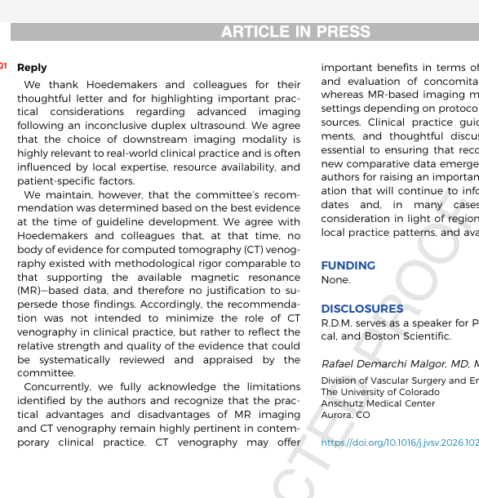
ARTICLE IN PRESS
Letter & reply: firm, flexible, and evidence-based
The critique:
CTV is clinically useful and often more practical than MRV in real-world settings.
The response:
•
We acknowledge real-world advantages of CT: availability, speed, cost, and concomitant anatomy.
•
The final recommendation was based on evidence strength, not preference or convenience.
•
No CTV body of evidence matched the methodological rigor of available MR-based data at the time.
•
Therefore MRV remains preferred when available — while CTV remains appropriate when clinical context requires it.
Not anti-CTV. Pro-evidence. Open to future comparative data.
Article reply and AVF UEDVT Clinical Practice Guideline, JVSVL 2026
8
Notes:
Use this slide to handle the letter. The tone should be firm: we did not ignore CT; we acknowledged its advantages. The recommendation was anchored to the strength and methodological quality of available evidence. Clinical practice can be flexible; guideline language has to be rigorous.

Slide 10
OPERATIONALIZE
Implementation agenda: build pathways, not debates
Turn the guideline into defaults that reduce variation.
Imaging pathway
Line-associated prophylaxis stop-point
Treatment defaults
DUS first; MRV/CTV escalation criteria for central disease; venography/IVUS for procedural candidates.
Order set hard-stop: no prophylaxis solely for long-term CVC unless VTE risk justifies it.
Xa inhibitor and ≥3 months duration when bleeding risk allows; catheter removal only when clinically appropriate.
vTOS referral lane
Documentation standard
Outcome tracking
Early identification of effort thrombosis and direct pathway to decompression evaluation.
Etiology, bleeding risk, access need, imaging rationale, and reason for invasive therapy.
PE, recurrent UEDVT, PTS symptoms, major bleeding, catheter salvage, and reintervention.
Aggressive standardization is how a guideline becomes care.
AVF UEDVT Clinical Practice Guideline, JVSVL 2026
9
Notes:
This is the practical bridge: emphasize order sets, pathways, documentation, and outcomes.

Slide 11
NEXT STEPS
AVF strategic lessons from the guideline process
The AVF should remain in the lead.
Use the expertise gained
Committee knowledge, evidence synthesis, external review, and publication logistics should be retained and refined.
Venous guidelines need venous expertise — and the organization has now built the muscle to do this well.
Invest in protected time and staff
High-quality guidelines are not side projects. They require dedicated project management, evidence support, and editorial discipline.
Protect the process
Move next to dissemination
International collaboration and multisocietal implementation are the next steps for durable practice change.
AVF UEDVT Clinical Practice Guideline, JVSVL 2026
10
Notes:
This slide reframes lessons learned as strategic recommendations for AVF.

Slide 12
Thank you
Discussion
On behalf of the AVF Guidelines Committee
Where does your institution still vary?
Yana Etkin, MD • Nicolas J. Mouawad, MD, MPH, MBA • Linda Le, MD • Leo Sullivan, MD • Eleftherios Xenos, MD • Limael Rodriguez, MD • Chandu Vemuri, MD, MBA • Eri Fukaya, MD, PhD • Brajesh K. Lal, MBBS • Pedro J. F. Neves, MD • Faisal Aziz, MD, MBA • Mikel Sadek, MD • Nathan Tomita, DO, MPH • Alessandra Puggioni, MD
Diagnosis • Prophylaxis • Treatment • Documentation
Final guideline DOI: 10.1016/j.jvsv.2026.102461
Notes:
Close by thanking the committee and moving discussion toward implementation barriers.

